Slide 1
Computer Networks
Course code: 21CSA212
Lecture: Evolution of Computer Networks

Slide 2
Introduction
Nowadays, Internet is the essential need for almost 60% of people in the world
How the internet evolved?
How we connect through air?

Slide 3
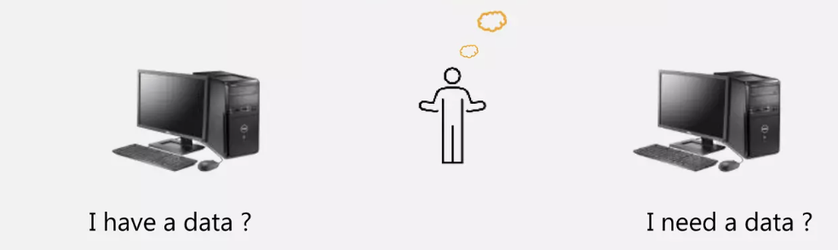
How we connect?

Slide 4
When the computer came into the world , that has a lot demand. The computer programmers started to code a system to do some operations. In a while there is no way to share the data from one machine to another. To overcome this issue, the system designers think :
How to connect two computers?

Slide 5
After long research they found to connect the computers with cables.
The cable is useful to transfer upto 10Kb/s
Since the data transfer time and the amount of data is enormous, that's not adequate to transfer data frequently.
Now the topology came into action to connect number of computers to make data transfer easy and to make the network to stay connected. With the topology, the wires also got updated(twisted wire, coaxial)

Slide 6
Evolution of Computer Networks
A network additionally enables associated PCs to share documents and information and also equipment assets, i.e., scanners, plotters, projectors, and storage devices, making it simpler to gather and administer data, and enabling clients to work together.
Advancement of systems administration began path back in 1969’s with the improvement of the first system called ARPANET.

Slide 7
ARPANET
Advanced Research Projects Agency Network
ARPANET came into existence in 1969
It was designed and named by the Advanced Research Projects Agency (ARPA) and the US Department of Defence (DoD)
It was where a bunch of PCs was associated at various colleges and US DoD for sharing information and messages and playing long separation diversions and associating with individuals to share their perspectives.

Slide 8
NSFNET
National Science Federation Network
The first backbone infrastructure for the commercial public Internet
Its main aim was to use networks only for academic research and not for any kind of private business activity

Slide 9
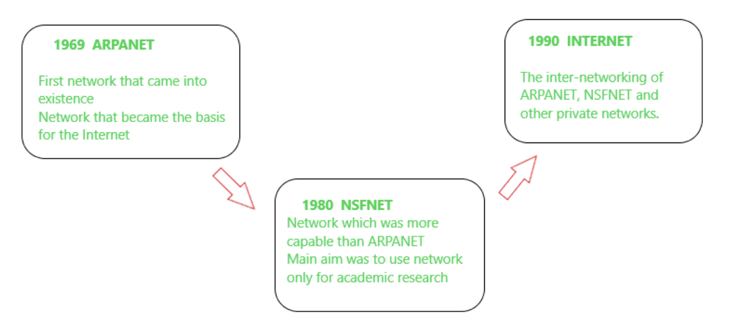
Internet
The internet is a globally connected network system that utilizes TCP/IP to transmit information.
It allows computers of different types to exchange information

Slide 10
Computer Networks
Collection of autonomous computers interconnected by a single technology.
The network size may vary from small to large depending on the number of computers it connects. A computer network can include different types of hosts (also called nodes) like server, desktop, laptop, cellular phones.
Networks also includes networking devices like routers, switch modem etc
Networking devices are used to connect multiple computers in different settings

Slide 11
Uses of Computer networks
Business Applications
Resource Sharing: The goal is to make all programs, equipment, and data available to anyone, regardless of the physical location of the resource or the user.
Group of people sharing common printer
Sales person in New York need to access a product inventory database in Singapore
Virtual Private Networks, VPN is used to join the individual networks at different sites into one extended network

Slide 12
Client-Server model
A server is a program that runs on the remote machine providing services to the clients.
Servers are the powerful computers where the data is stored
They are maintained by a system administrator.
A client is a program that runs on the local machine requesting service from the server.
Web application: Server generates web pages based on its database in response to client requests that may update the database.

Slide 13
Communication medium
Computer network provide powerful communication medium among employees
Email: employees generally use for a great deal of daily communication
Telephone calls can be carried by the computer network instead of phone.
This technology is known as Voice over IP
Desktop Sharing: Helps remote workers see and interact with the computer screen.

Slide 14
E-commerce
Convenience of shopping from home
Companies provide catalogs of their goods and services online and take orders online

Slide 15
Types of Computer Networks
A computer network can be categorized by their size.
A computer network is mainly of four types:
LAN (Local Area Network)
PAN (Personal Area Network)
MAN (Metropolitan Area Network)
WAN (Wide Area Network)

Slide 16
Personal Area Network
Devices communicate over the range of a person
PAN offers a network range of 1 to 100 meters from person to device providing communication.
Its transmission speed is very high with very easy maintenance and very low cost.
There are two types of PAN: Wireless Personal Area Network and Wired Personal Area Network
Example: a wireless network that connects a computer with its peripherals. Bluetooth

Slide 17
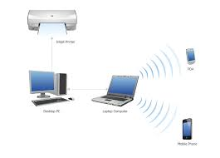
Wireless Personal Area Network(WPAN)
(WPAN) is connected through signals such as infrared, Bluetooth..
Wired PAN is connected through cables/wires or USB

Slide 18
Local Area Network
Privately owned network that operates within and nearby a single building such as home, office.
Connecting two or more personal computers through a communication medium such as twisted pair, coaxial cable, etc
When LANs are used by companies, they are called as enterprise networks.
Standard for wireless LANs called IEEE 802.11, popularly known as WiFi

Slide 19
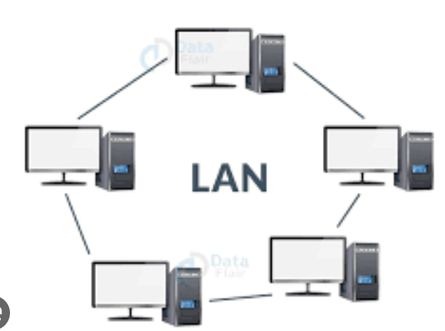
IEEE 802.3 , Ethernet is the most common type of wired LAN.
It is less costly as it is built with inexpensive hardware
It ranges up to 2km & transmission speed is very high with easy maintenance and low cost.

Slide 20
Metropolitan Area Networks
This is the type of computer network that connects computers over a geographical distance through a shared communication path over a city, town, or metropolitan area.
Its transmission speed is average.
It is difficult to maintain and it comes with a high cost.
It can be used in communication between banks, cable television networks, airline reservation…

Slide 21
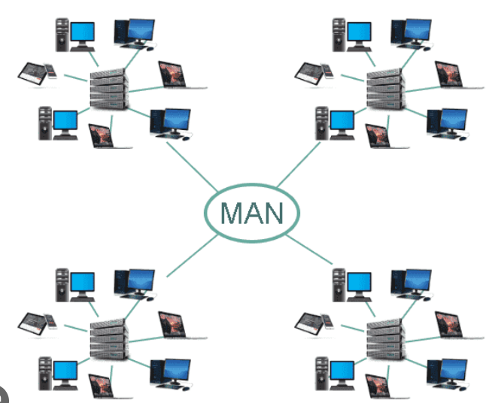
MAN
￼

Slide 22
Wide Area Network
This is a type of computer network that connects computers over a large geographical distance through a shared communication path.
It is not restrained to a single location but extends over many locations.
WAN can also be defined as a group of local area networks that communicate with each other with a range above 50km.
Its transmission speed is very low and it comes with very high maintenance and very high cost.

Slide 23
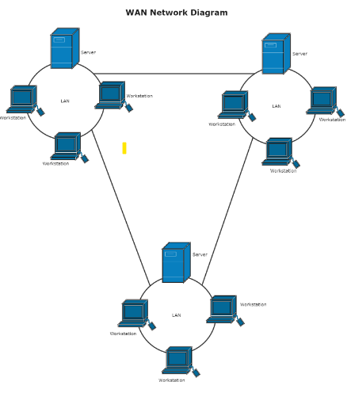
WAN
￼

Slide 24
Types of network topologies
Network Topology is the way that defines the structure, and how these components are connected to each other
The various network topologies are:
Point to Point Topology
Mesh Topology
Star Topology
Bus Topology
Ring Topology

Slide 25
Network topologies
Tree Topology
Hybrid Topology

Slide 26
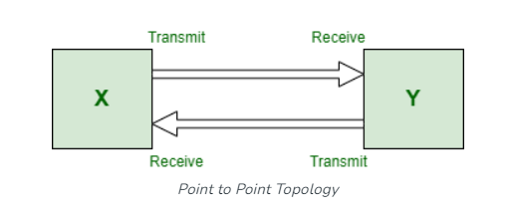
Point to Point Topology
It is the simplest communication between two nodes, in which one is the sender and the other one is the receiver.
Point-to-Point provides high bandwidth.

Slide 27
Bus Topology
A network type in which every computer and network device is connected to a single cable called backbone cable
It is bi-directional.
It is a multi-point connection and a non-robust topology because if the backbone fails the topology crashes
When a node wants to send a message over the network, it puts a message over the network. All the stations available in the network will receive the message whether it has been addressed or not.

Slide 28
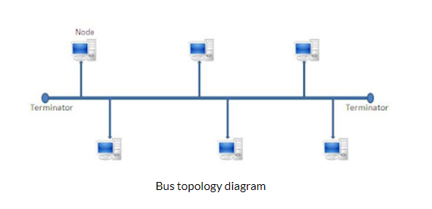
The backbone cable is considered as a "single lane" through which the message is broadcast to all the stations.
The most common access method of the bus topologies is CSMA (Carrier Sense Multiple Access)
CSMA: It is a media access control used to control the data flow so that data integrity is maintained. There are two alternative ways of handling the problems that occur when two nodes send the messages simultaneously.

Slide 29
Carrier Sense Multiple Access
CSMA CD (Collision detection) is an access method used to detect the collision. Once the collision is detected, the sender will stop transmitting the data. Therefore, it works on "recovery after the collision".
CSMA CA (Collision Avoidance) is an access method used to avoid the collision by checking whether the transmission media is busy or not. If busy, then the sender waits until the media becomes idle. This technique effectively reduces the possibility of the collision. It does not work on "recovery after the collision".

Slide 30
Advantages:
Low-cost cable: In bus topology, nodes are directly connected to the cable without passing through a hub. Therefore, the initial cost of installation is low.
Moderate data speeds: Coaxial or twisted pair cables are mainly used in bus-based networks that support upto 10 Mbps.
Familiar technology: Bus topology is a familiar technology as the installation and troubleshooting techniques are well known, and hardware components are easily available.
Limited failure: A failure in one node will not have any effect on other nodes.

Slide 31
Disadvantage:
Extensive cabling: A bus topology is quite simpler, but still it requires a lot of cabling.
Difficult troubleshooting: It requires specialized test equipment to determine the cable faults. If any fault occurs in the cable, then it would disrupt the communication for all the nodes.
Signal interference: If two nodes send the messages simultaneously, then the signals of both the nodes collide with each other.
Reconfiguration difficult: Adding new devices to the network would slow down the network.
Attenuation: Attenuation is a loss of signal leads to communication issues. Repeaters are used to regenerate the signal.

Slide 32
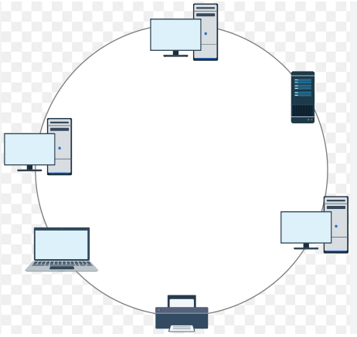
Ring Topology
In ring topology, each host machine connects to exactly two other machines, creating a circular network structure.
The data flows in one direction, i.e., it is unidirectional.
When one host tries to communicate or send message to a host which is not adjacent to it, the data travels through all intermediate hosts.
Failure of any host results in failure of the whole ring.
to prevent data loss repeaters are used in the network.
The most common access method of ring topology is token passing.

Slide 33
Working of Ring topology
One station is known as a monitor station which takes all the responsibility for performing the operations.
To transmit the data, the station has to hold the token. After the transmission is done, the token is to be released for other stations to use.
When no station is transmitting the data, then the token will circulate in the ring.
There are two types of token release techniques: Early token release releases the token just after transmitting the data and Delayed token release releases the token after the acknowledgment is received from the receiver.

Slide 34
Advantages
The data transmission is high-speed.
The possibility of collision is minimum in this type of topology.
Cheap to install and expand.
It is less costly than a star topology.

Slide 35
Drawbacks
The failure of a single node in the network can cause the entire network to fail.
Troubleshooting is difficult in this topology.
The addition of stations in between or the removal of stations can disturb the whole topology.
Less secure.

Slide 36
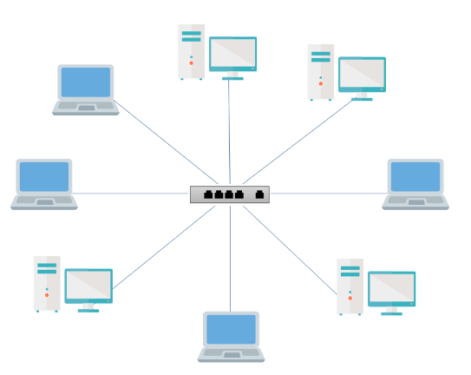
Star Topology
All the devices are connected to a single hub through a cable(point-to-point).
This hub is the central node and all other nodes are connected to the central node.

Slide 37
The central computer is known as a server, and the peripheral devices attached to the server are known as clients.
Coaxial cable or RJ-45 cables are used to connect the computers

Slide 38
Advantages
Efficient troubleshooting: Troubleshooting is quite efficient in a star topology as compared to bus topology. In a bus topology, the manager has to inspect the kilometers of cable. In a star topology, all the stations are connected to the centralized network. Therefore, the network administrator has to go to the single station to troubleshoot the problem.
Network control: Complex network control features can be easily implemented in the star topology. Any changes made in the star topology are automatically accommodated.
Limited failure: As each station is connected to the central hub with its own cable, therefore failure in one cable will not affect the entire network.

Slide 39
Advantages
Familiar technology: Star topology is a familiar technology as its tools are cost-effective.
Easily expandable: It is easily expandable as new stations can be added to the open ports on the hub.
Cost effective: Star topology networks are cost-effective as it uses inexpensive coaxial cable.
High data speeds: It supports a bandwidth of approx 100Mbps. Ethernet 100BaseT is one of the most popular Star topology networks.

Slide 40
Disadvantages
A Central point of failure: If the central hub or switch goes down, then all the connected nodes will not be able to communicate with each other.
Cable: Sometimes cable routing becomes difficult when a significant amount of routing is required.

Slide 41
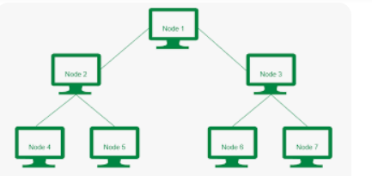
Tree topology
Tree topology combines the characteristics of bus topology and star topology.
A tree topology is a type of structure in which all the computers are connected with each other in hierarchical fashion.
Also known as Hierarchical Topology
The top-most node in tree topology is known as a root node, and all other nodes are the descendants of the root node.
There is only one path exists between two nodes for the data transmission. Thus, it forms a parent-child hierarchy.

Slide 42
Advantages
Support for broadband transmission: Tree topology is mainly used to provide broadband transmission, i.e., signals are sent over long distances without being attenuated.
Easily expandable: We can add the new device to the existing network. Therefore, we can say that tree topology is easily expandable.
Easily manageable: In tree topology, the whole network is divided into segments known as star networks which can be easily managed and maintained.

Slide 43
Error detection: Error detection and error correction are very easy in a tree topology.
Limited failure: The breakdown in one station does not affect the entire network.
Point-to-point wiring: It has point-to-point wiring for individual segments.

Slide 44
Disadvantages
Difficult troubleshooting: If any fault occurs in the node, then it becomes difficult to troubleshoot the problem.
High cost: Devices required for broadband transmission are very costly.
Failure: A tree topology mainly relies on main bus cable and failure in main bus cable will damage the overall network.
Reconfiguration difficult: If new devices are added, then it becomes difficult to reconfigure

Slide 45
Mesh Topology
Arrangement of the network in which computers are interconnected with each other through various redundant connections.
There are multiple paths from one computer to another computer
It does not contain the switch, hub or any central computer which acts as a central point of communication.
The Internet is an example of the mesh topology.
Mesh topology is mainly used for WAN implementations where communication failures are a critical concern.
Mesh topology is mainly used for wireless networks.

Slide 46
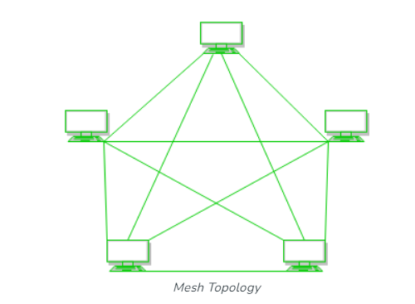
Mesh topology is divided into two categories
Full Mesh Topology: In a full mesh topology, each computer is connected to all the computers available in the network.
Partial Mesh Topology: In a partial mesh topology, not all but certain computers are connected to those computers with which they communicate frequently

Slide 47
Advantages
Communication is very fast between the nodes.
The fault is diagnosed easily. Data is reliable because data is transferred among the devices through dedicated channels or links.
Provides security and privacy.

Slide 48
Drawbacks
Installation and configuration are difficult.
The cost of cables is high as bulk wiring is required, hence suitable for less number of devices.
The cost of maintenance is high.

Slide 49
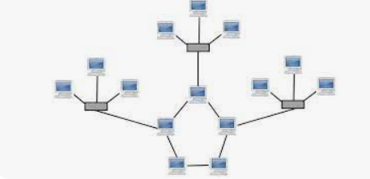
Hybrid topology
The combination of various different topologies is known as Hybrid topology.
A Hybrid topology is a connection between different links and nodes to transfer the data.

Slide 50
Advantages of Hybrid Topology
This topology is very flexible.
The size of the network can be easily expanded by adding new devices.
Drawbacks of Hybrid Topology
It is challenging to design the architecture of the Hybrid Network.
Hubs used in this topology are very expensive.
The infrastructure cost is very high as a hybrid network requires a lot of cabling and network devices.

